Slide 1
Discrete Structure Set Theory (Part 2)
Week 6
By
Dr. Rafiullah Khan

Slide 2
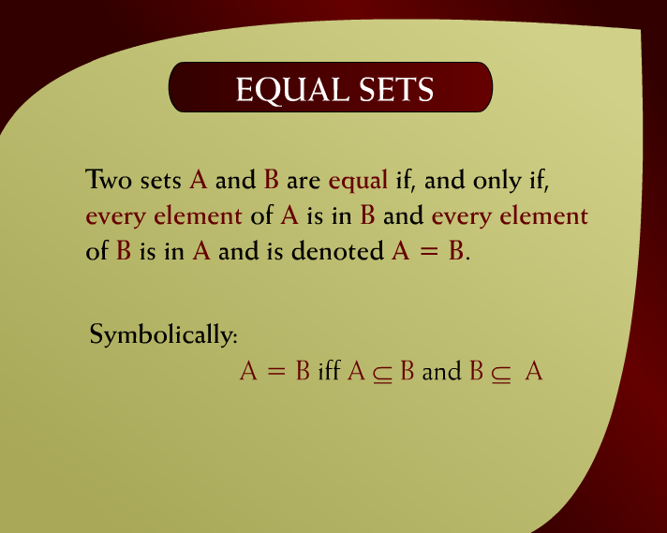
Equal Sets – (7 - 13)

Slide 3
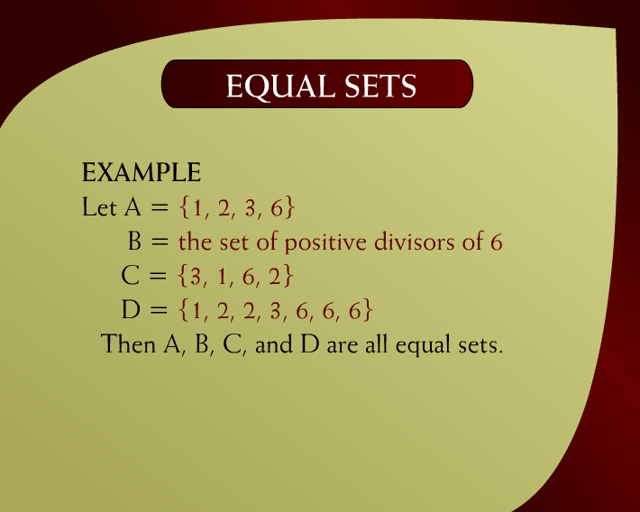
Equal Sets – (7 – 13a)

Slide 4
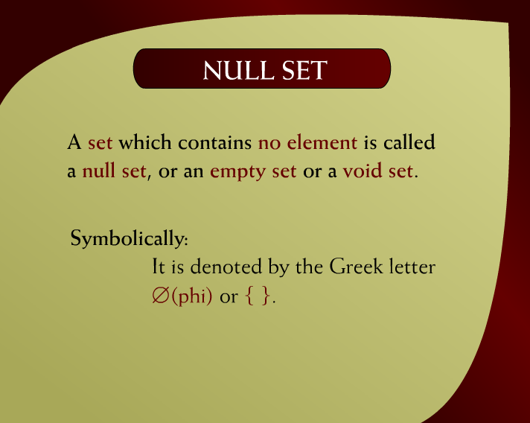
Null Set – (7 - 14)

Slide 5
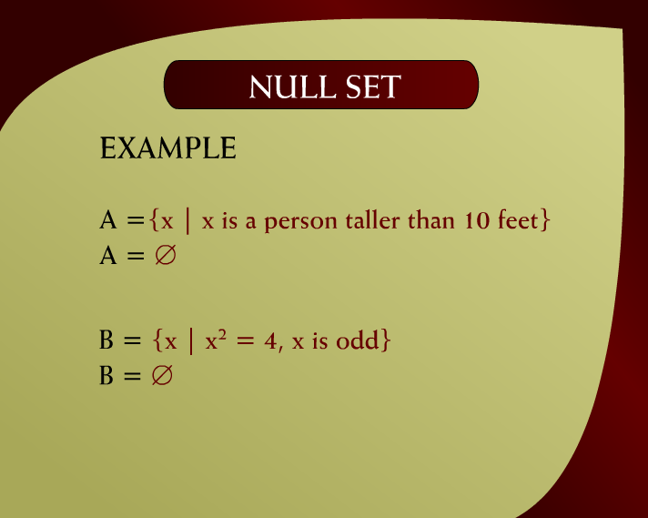
Null Set – (7 – 14a)

Slide 6
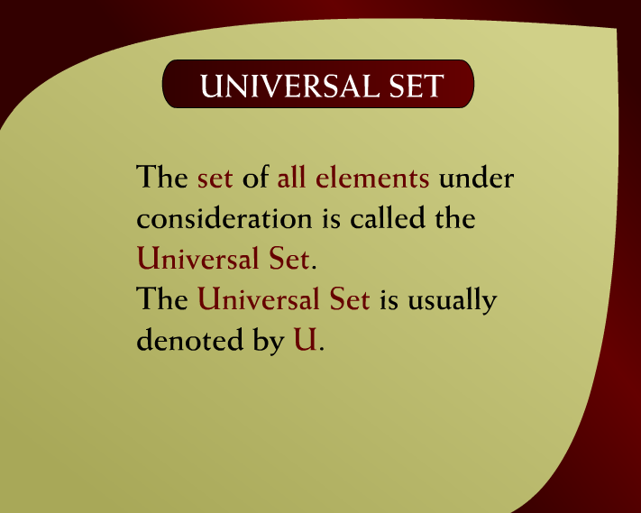
Universal Set – (7 - 16)

Slide 7
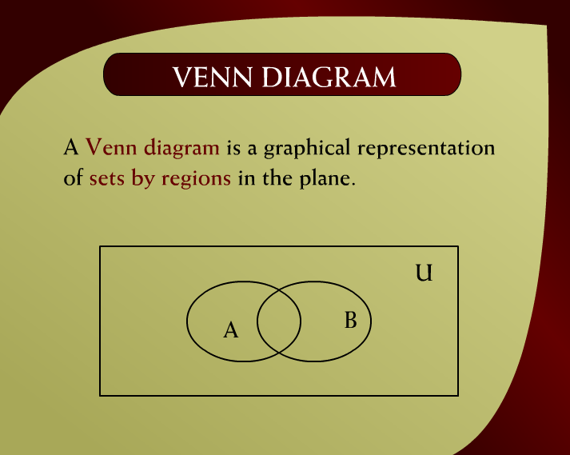
Venn Diagram – (7 - 17)

Slide 8
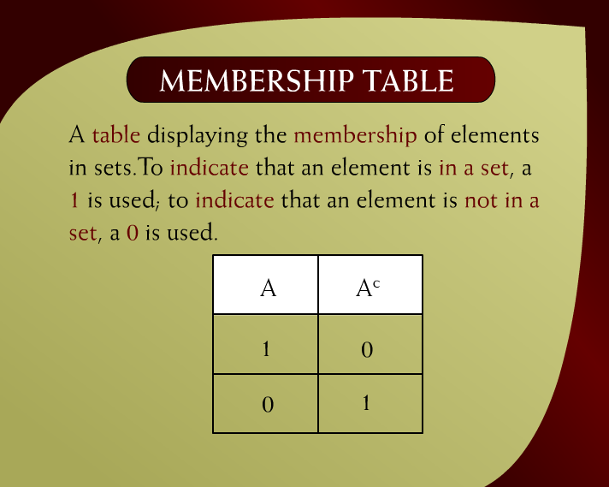
Membership Table – (7 - 20)

Slide 9
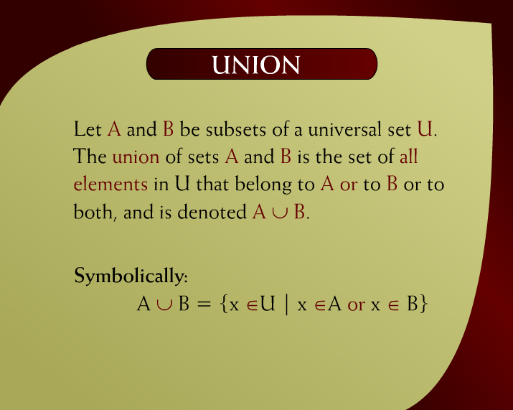
Union – (8 - 2)

Slide 10
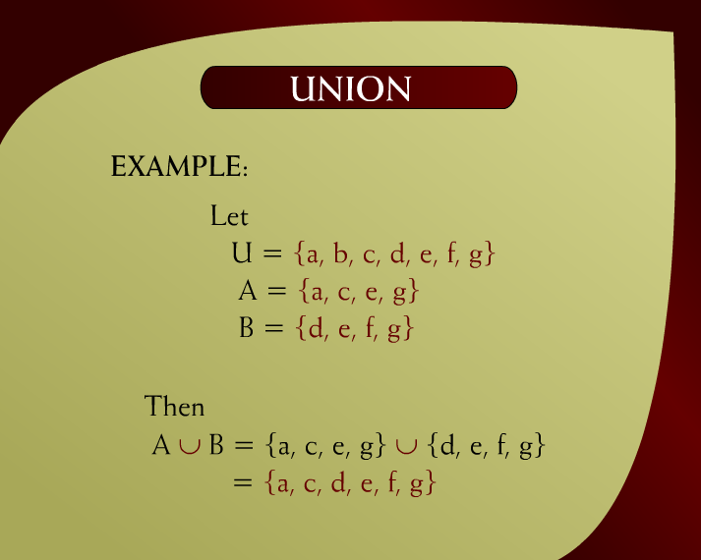
Union – (8 – 2a)

Slide 11
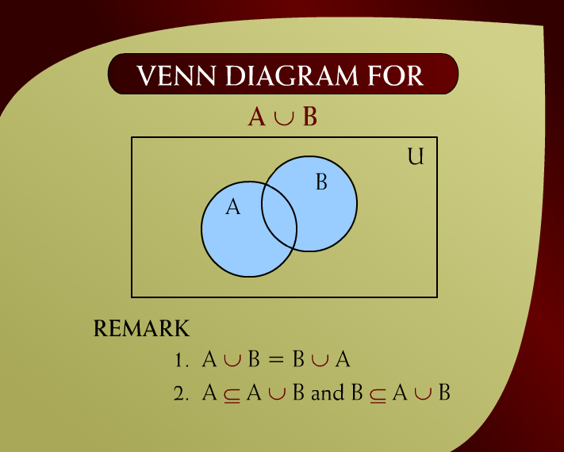
Venn Diagram – (8 - 3)

Slide 12
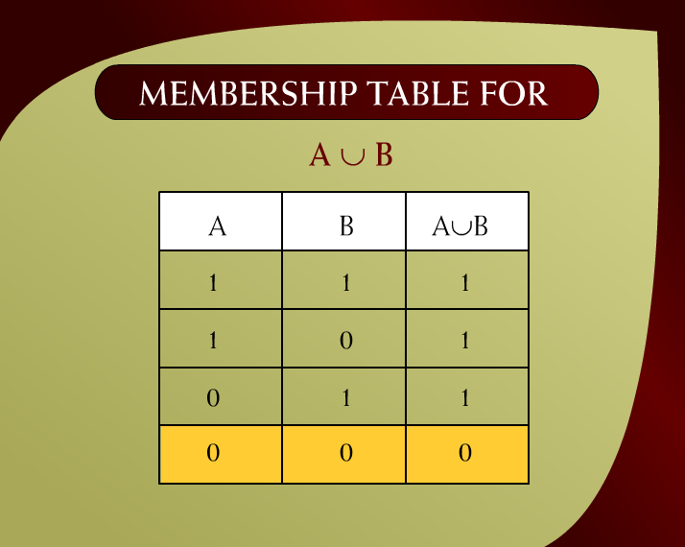
Membership Table – (8 - 4)

Slide 13
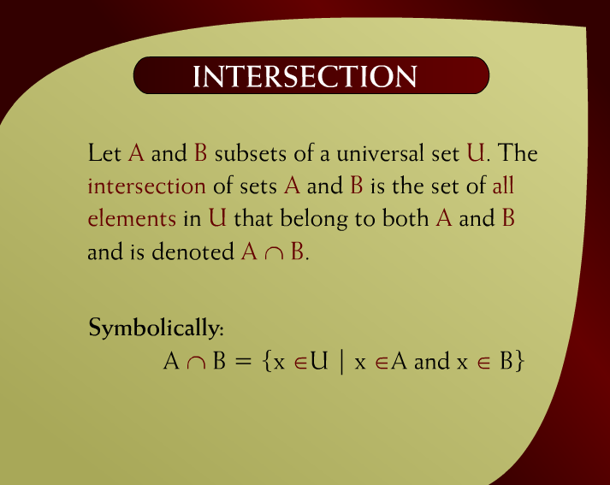
Intersection – (8 - 5)

Slide 14
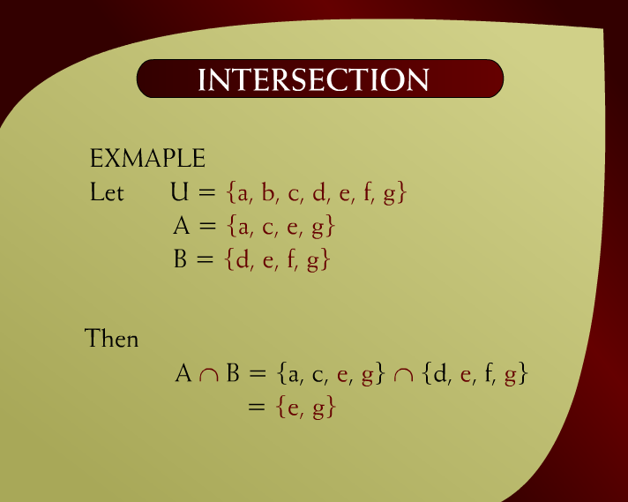
Intersection – (8 – 5a)

Slide 15
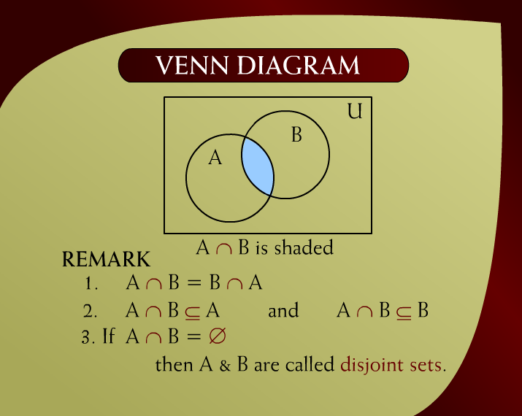
Venn Diagram – (8 - 6)

Slide 16
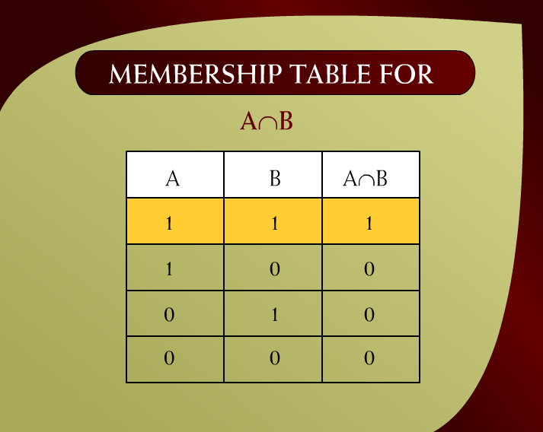
Membership Table – (8 - 7)

Slide 17

Set Difference – (8 - 8)

Slide 18

Set Difference – (8 – 8a)

Slide 19
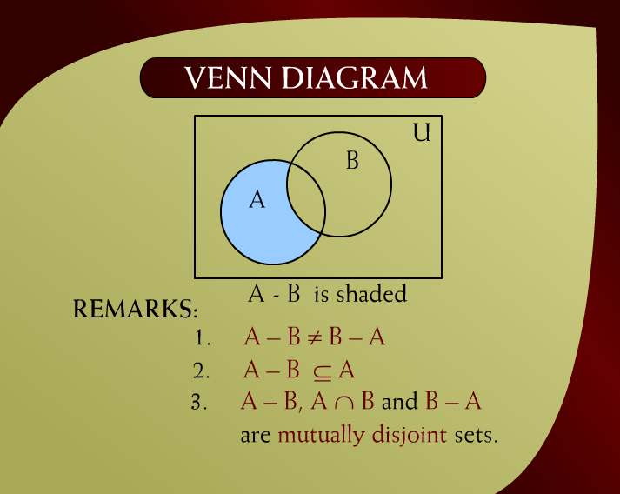
Venn Diagram – (8 - 9)

Slide 20
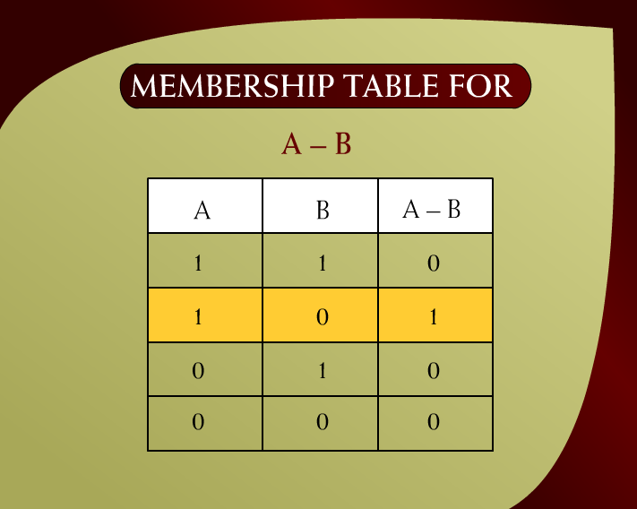
Membership Table – (8 - 10)

Slide 21
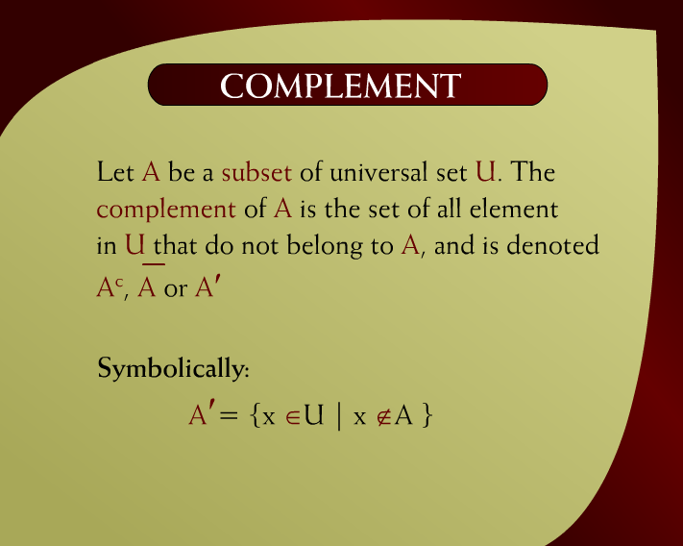
Complement – (8 - 11)

Slide 22

Complement – (8 – 11a)

Slide 23
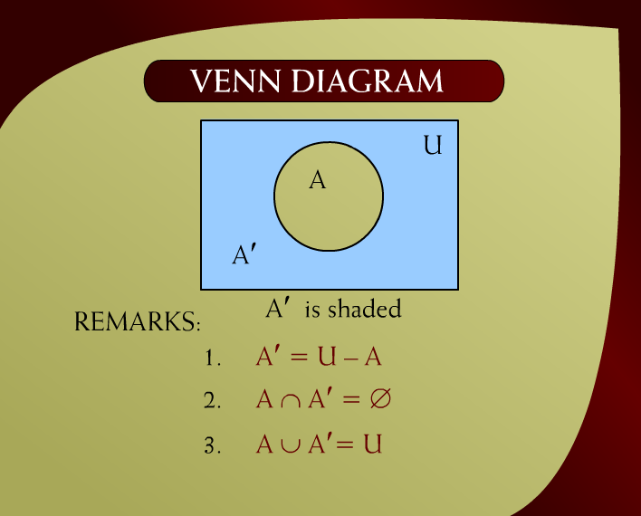
Venn Diagram – (8 - 12)

Slide 24
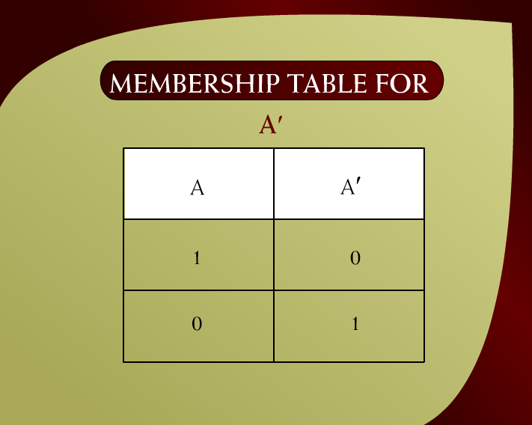
Membership Table – (8 - 13)

Slide 25
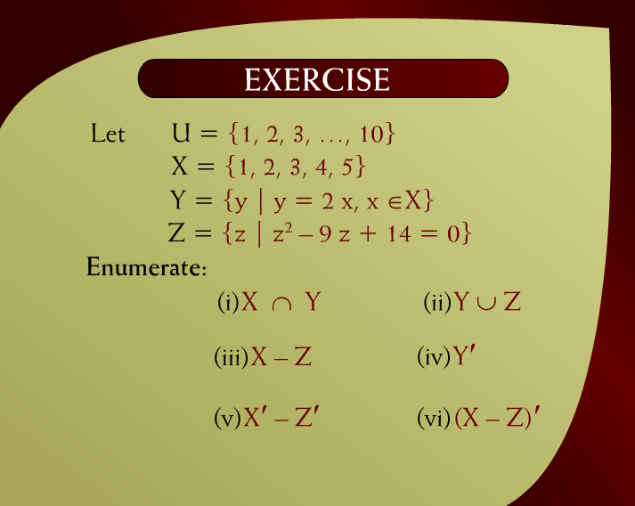
Exercise – (8 - 14)

Slide 26
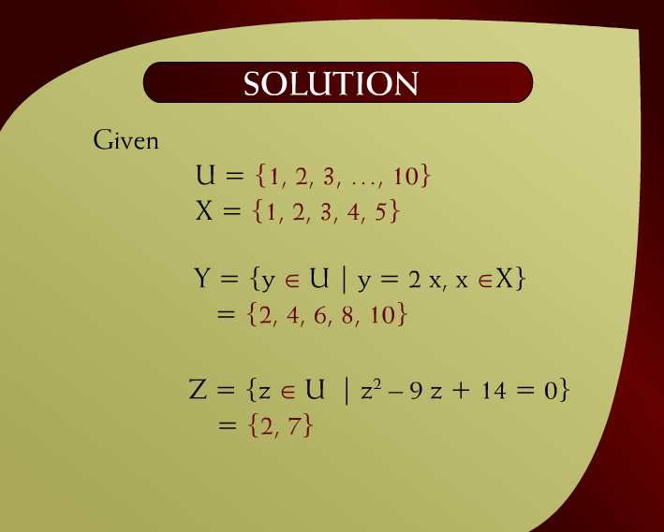
Solution – (8 - 15)

Slide 27
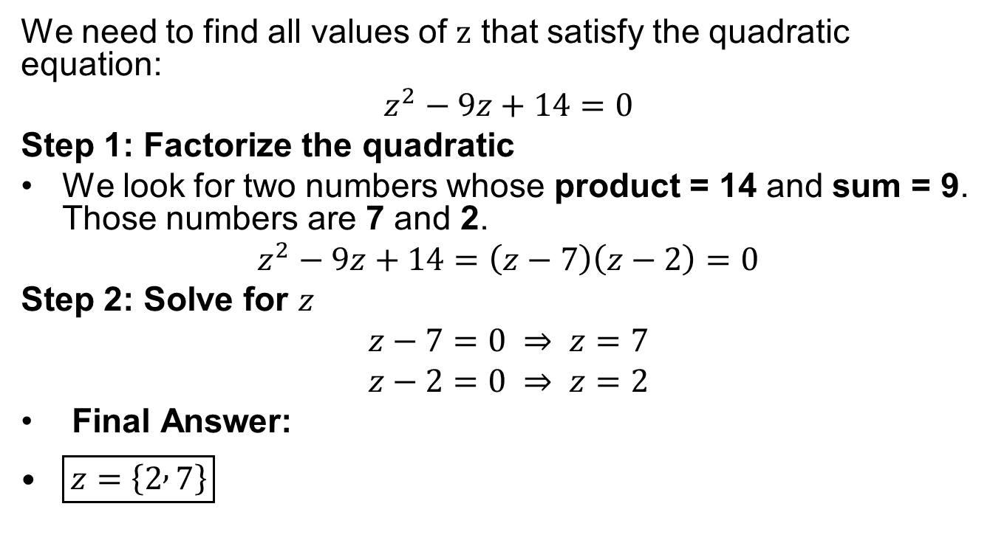
How you Got Z = {2, 14}
We need to find all values of $z$ that satisfy the quadratic equation:
$$z^{2}−9z+14=0$$
Step 1: Factorize the quadratic
We look for two numbers whose product = 14 and sum = 9. Those numbers are 7 and 2.
$$z^{2}−9z+14=\left(z−7\right)\left(z−2\right)=0$$
Step 2: Solve for $z$
$$z−7=0 ⇒ z=7$$
$$z−2=0 ⇒ z=2$$
Final Answer:
$\boxed{z=\left\{2 , 7\right\}}$

Slide 28
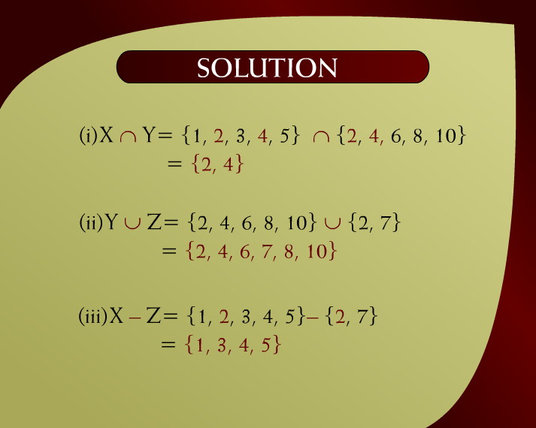
Solution – (8 – 15a)

Slide 29
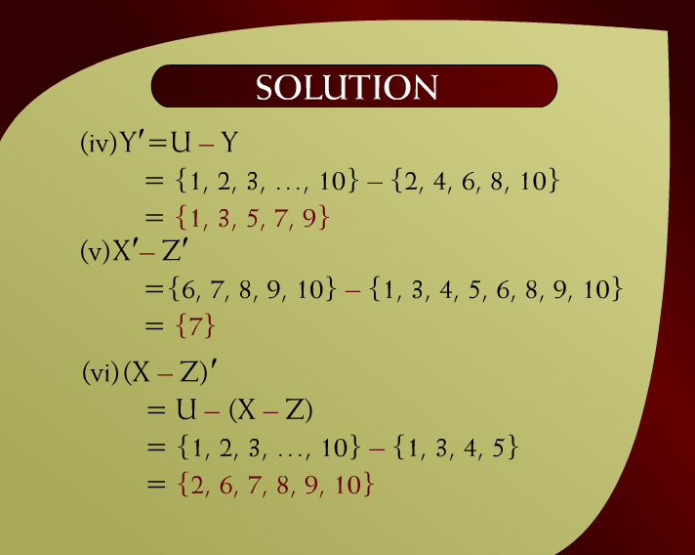
Solution – (8 – 15b)

Slide 30

Exercise – (8 - 17)

Slide 31
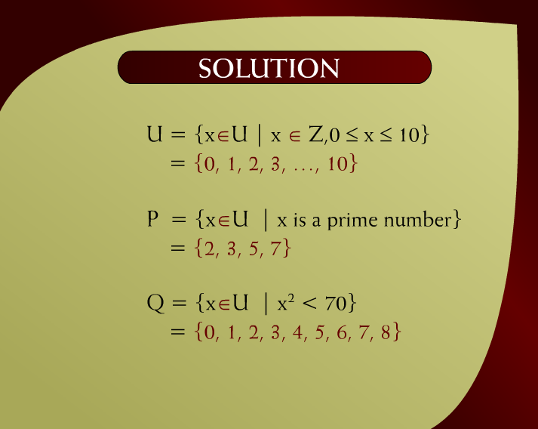
Solution – (8 - 18)

Slide 32
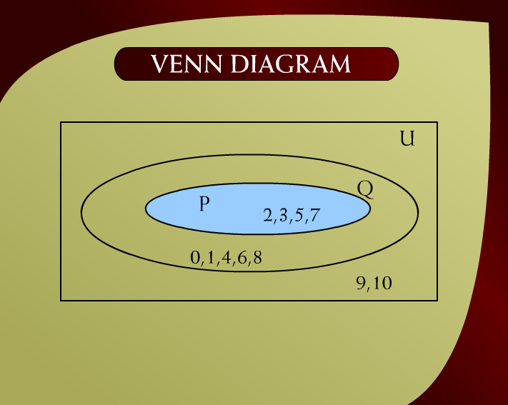
Venn Diagram – (8 - 19)

Slide 33
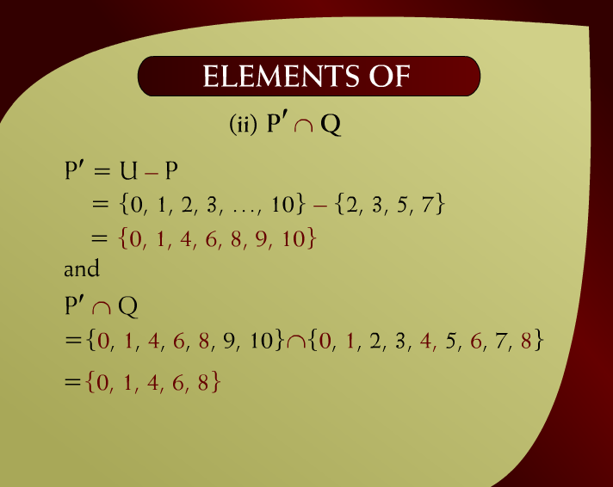
Elements of - (8 – 19a)

Slide 34
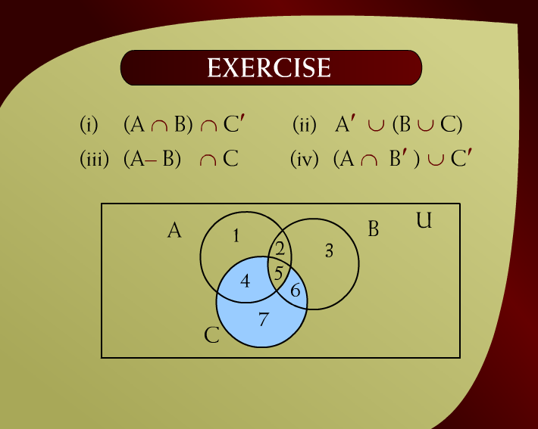
Exercise – (8 - 24)

Slide 35
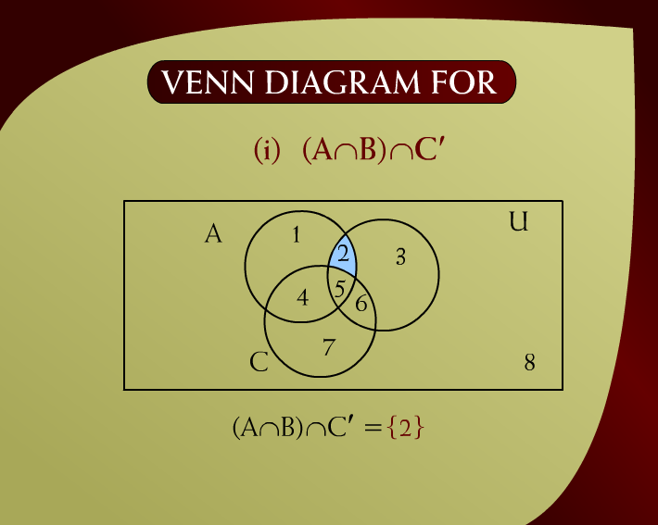
Venn Diagram – (8 - 25)

Slide 36
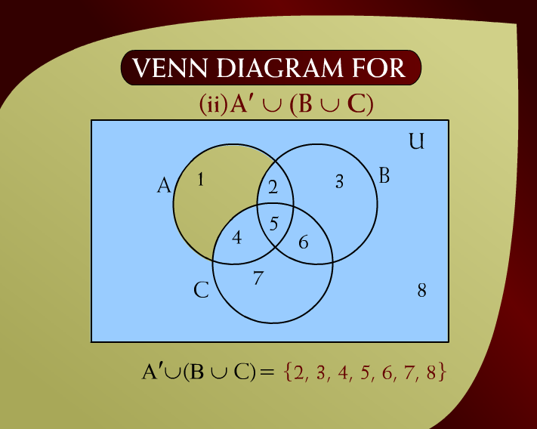
Venn Diagram – (8 - 26)

Slide 37
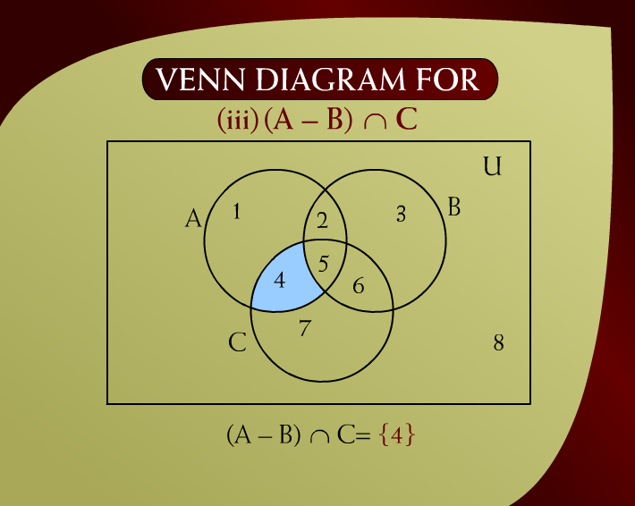
Venn Diagram – (8 - 27)

Slide 38
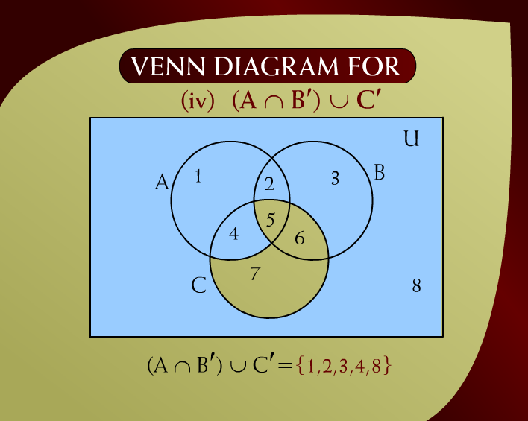
Venn Diagram – (8 - 28)

Slide 39
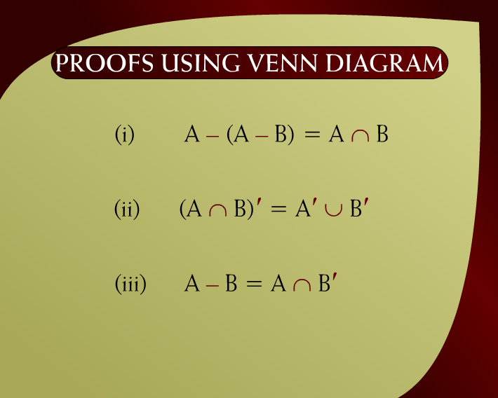
Proofs Using Venn Diagram – (8 - 29)

Slide 40
U
A
B

Slide 41
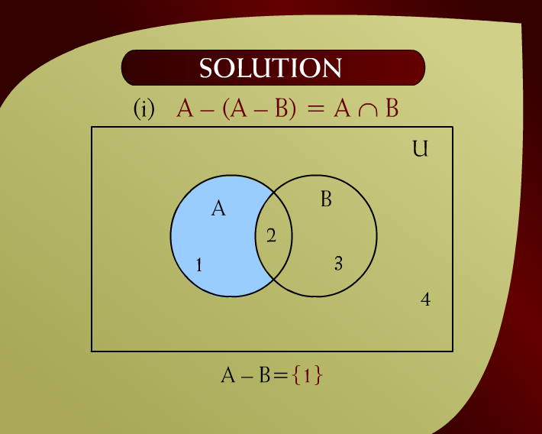
Solution – (8 - 30)

Slide 42
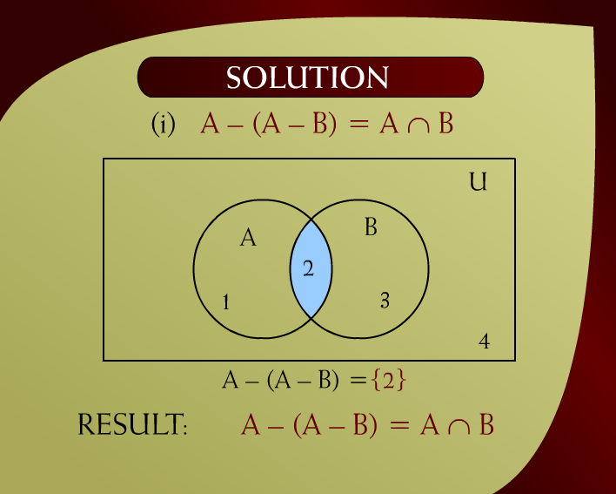
Solution – (8 - 31)

Slide 43

Solution – (8 - 32)

Slide 44
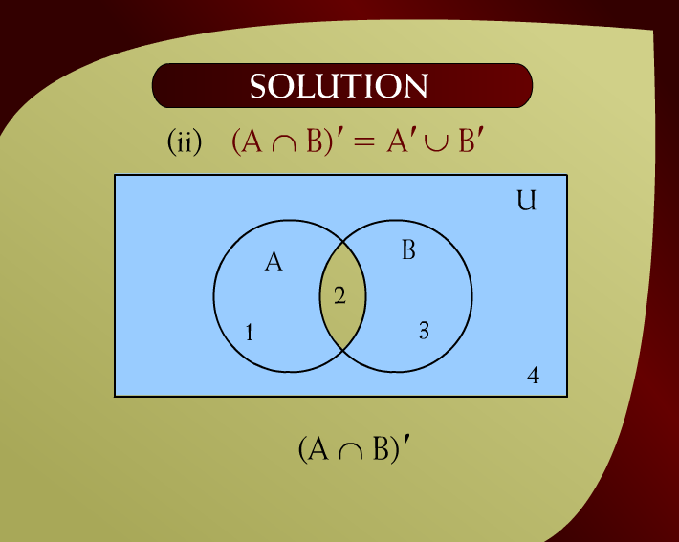
Solution – (8 – 32a)

Slide 45
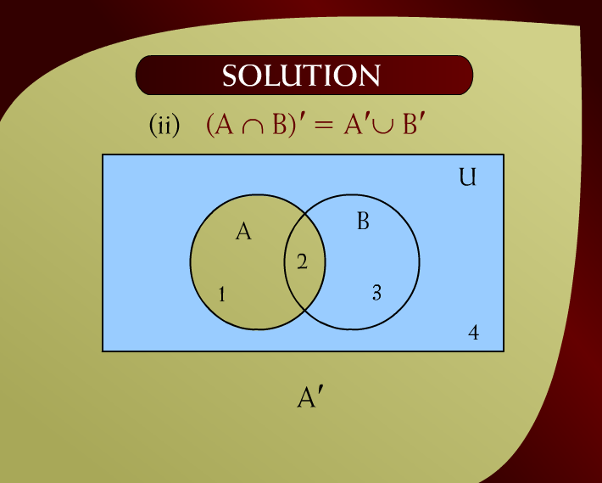
Solution – (8 - 33)

Slide 46
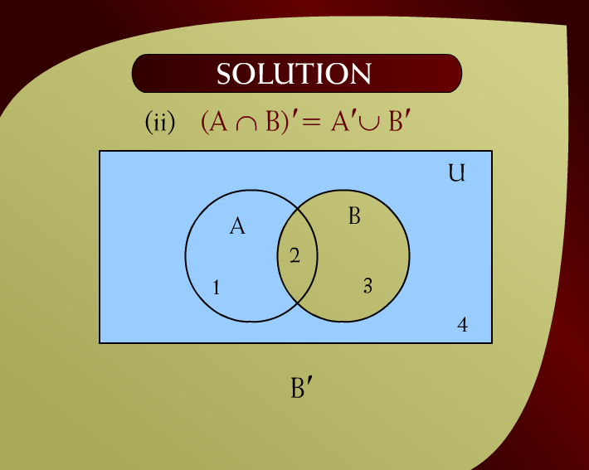
Solution – (8 – 33a)

Slide 47
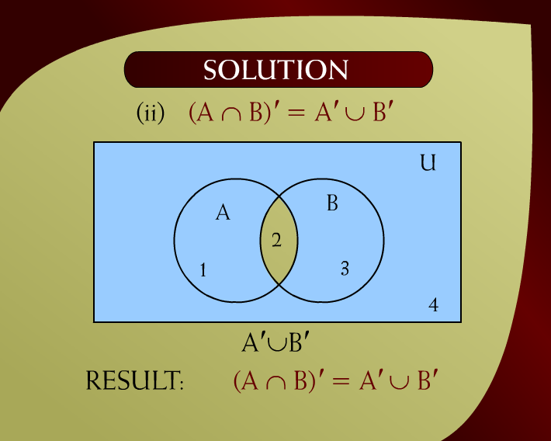
Solution – (8 - 34)

Slide 48

Solution – (8 – 35a)

Slide 49
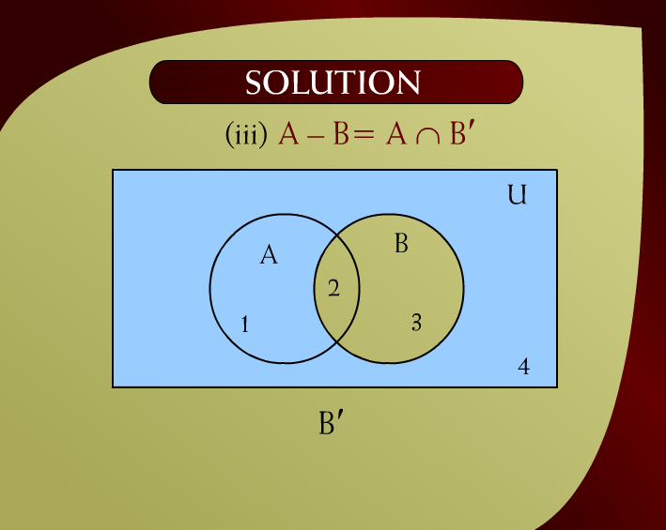
Solution – (8 – 35b)

Slide 50

Solution – (8 - 36)

Slide 51
Homework

Slide 52
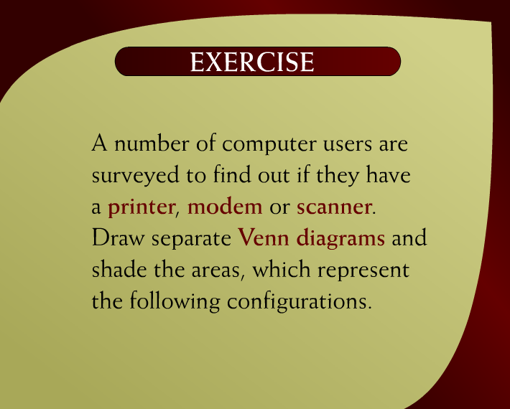
Exercise – (10 - 2)

Slide 53

Exercise – (10 – 2b)

Slide 54
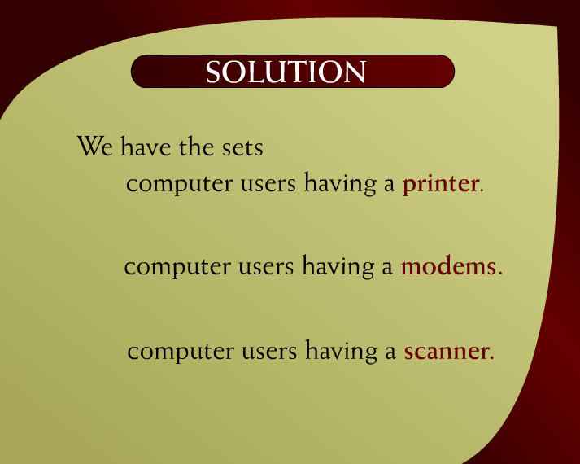
Solution – (10 – 2c)

Slide 55
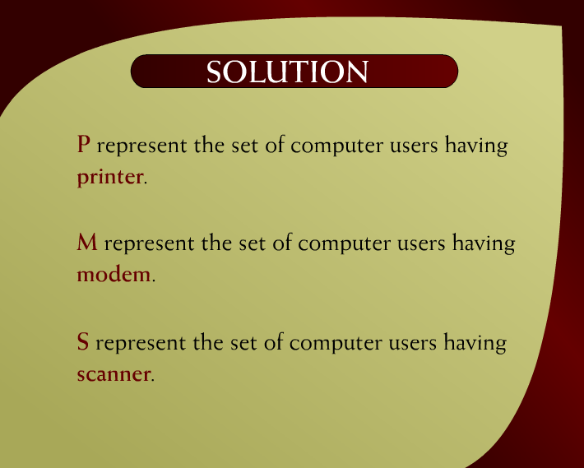
Solution – (10 – 2a)

Slide 56
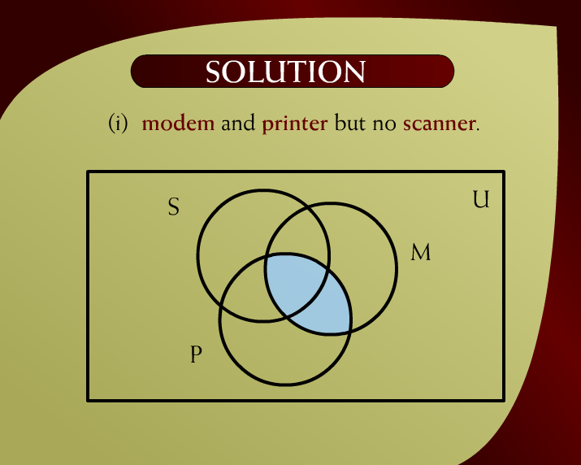
Solution – (10 - 3)

Slide 57
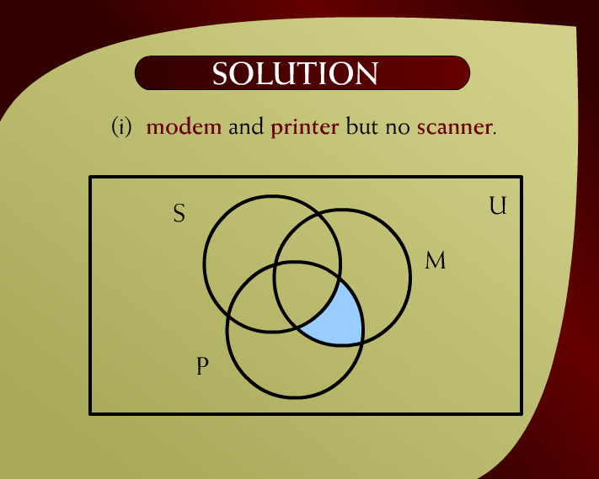
Solution – (10 - 3)

Slide 58
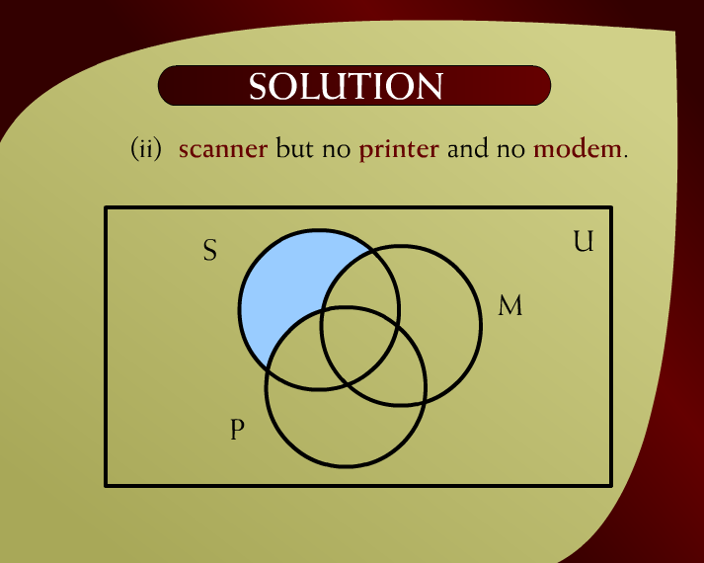
Solution – (10 – 4)

Slide 59
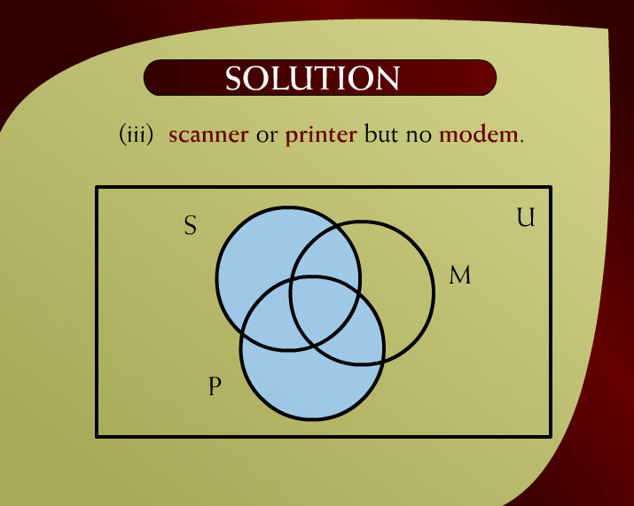
Solution – (10 - 5)

Slide 60
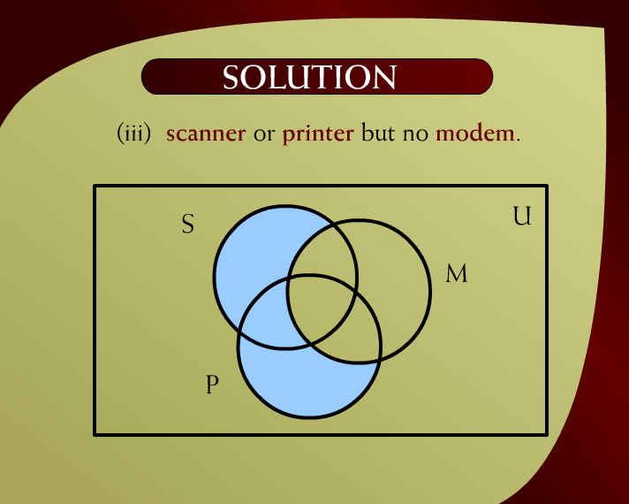
Solution – (10 - 5)

Slide 61
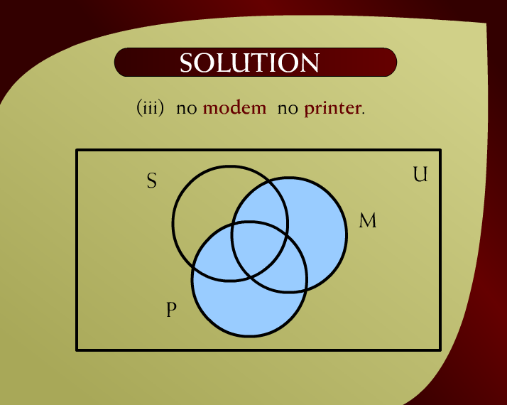
Solution – (10 - 6)

Slide 62

Solution – (10 - 6)

